Slide 1
Solving the Steady Heat Equation
With fortran

Slide 2
What is the heat equation ?
The problem -
Metal
What is the distribution of temperature of this metallic plate?
150⁰ C
20⁰ C
70⁰ C
210⁰ C

Slide 3
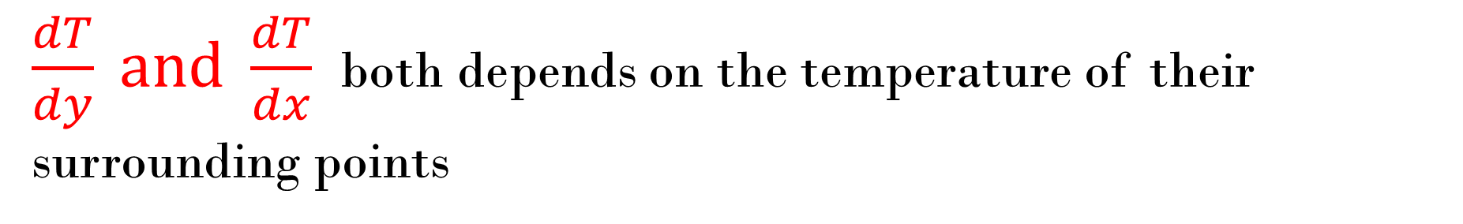
X
The rate of change of temperature of the white point depends on the temperature of surrounding points
Y
O
$\frac{dT}{dy} and \frac{dT}{dx}$ both depends on the temperature of their surrounding points

Slide 4


Partial derivatives $\frac{\text{∂}\text{2}\text{T}}{\text{∂}x2}$ and $\frac{\text{∂}\text{2}\text{T}}{\text{∂}y2}$ gives us whole idea of temperature change of a point
General Principle for heat equation in 2D
$\frac{\text{∂}\text{T}}{\text{∂}t}$∝ ($\frac{\text{∂}\text{2}\text{T}}{\text{∂}x2}$+ $\frac{\text{∂}\text{2}\text{T}}{\text{∂}y2}$) ⇨ $\frac{\text{∂}\text{T}}{\text{∂}t}$= β($\frac{\text{∂}\text{2}\text{T}}{\text{∂}x2}$+ $\frac{\text{∂}\text{2}\text{T}}{\text{∂}y2}$)
For steady heat equation (Temporary) $\frac{\text{∂}\text{T}}{\text{∂}t}$= 0

Slide 5
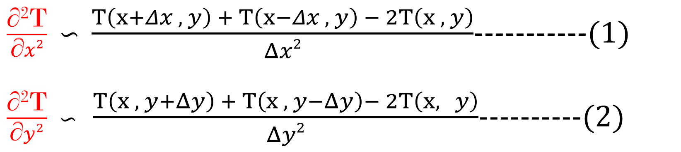

So we get ⇨ $\frac{\text{∂}\text{2}\text{T}}{\text{∂}x2}$+ $\frac{\text{∂}\text{2}\text{T}}{\text{∂}y2}$ = 0, For T (x , y)
Numerical Solution :
By 2nd derivative midpoint formula ,
$\frac{\text{∂}\text{2}\text{T}}{\text{∂}x2}$ ∽ $\frac{T\left(x+Δx , y\right) + T\left(x−Δx , y\right) − 2T\left(x , y\right)}{Δx2}$-----------(1)
$\frac{\text{∂}\text{2}\text{T}}{\text{∂}y2}$ ∽ $\frac{T\left(x , y+Δy\right) + T\left(x , y−Δy\right)− 2T\left(x, y\right)}{Δy2}$----------(2)

Slide 6
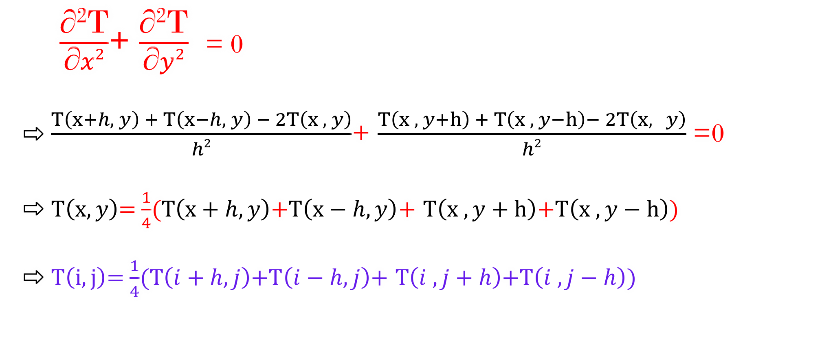
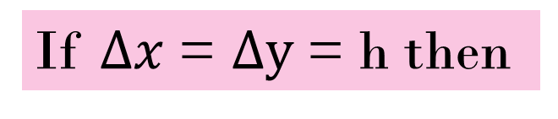
If $Δx$ = $Δy$ = h then
$\frac{\text{∂}\text{2}\text{T}}{\text{∂}x2}$+ $\frac{\text{∂}\text{2}\text{T}}{\text{∂}y2}$ = 0
⇨ $\frac{T\left(x+h, y\right) + T\left(x−h, y\right) − 2T\left(x , y\right)}{h2}$+ $\frac{T\left(x , y+h\right) + T\left(x , y−h\right)− 2T\left(x, y\right)}{h2}$ =0
⇨ $T\left(x,y\right)$= $\frac{1}{4}$($T\left(x+h, y\right)\text{+}T\left(x−h, y\right)$+ $T\left(x , y+h\right)\text{+}T\left(x , y−h\right)$)
⇨ $T\left(i,j\right)$= $\frac{1}{4}$($T\left(i+h, j\right)\text{+}T\left(i−h, j\right)$+ $T\left(i , j+h\right)\text{+}T\left(i , j−h\right)$)

Slide 7
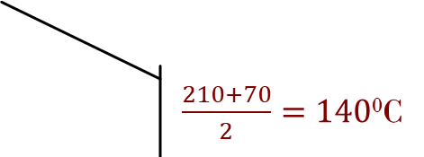
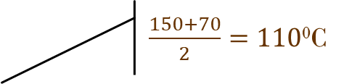
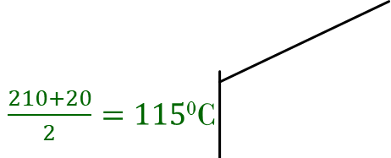
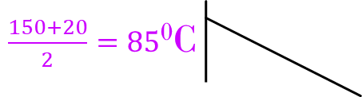
LET’S GO TO THE CODE
$\frac{150+20}{2}=85$⁰C
$\frac{150+70}{2}=110$⁰C
150⁰ C
h = .7 m
20⁰ C
70⁰ C
210⁰ C
$\frac{210+20}{2}=115$⁰C
$\frac{210+70}{2}=140$⁰C
b = .5 m

